Slide 1
Springfield College
AmeriCorps 2018–2019
Member Meeting
December 2018
(This will be available in the Resources Section on the OnCorps Portal)

Slide 2
Agenda
Sign In
Take Scrap Paper and Pencil
Name Check In & One Word or Phrase
How are you feeling today?
Updates:
Volunteer Opportunities
Mid-year Training
End of the Year Banquet
Data entry – caseloads –Student pre-surveys
Like us on Facebook, Follow us on Instagram and/or Twitter
Service Project Panel & Reminders
Letters from Teddy - Discussion / Partner Exercise
Word Cloud
The Do’s and Don’ts of Workplace Attire
Questions

Slide 3
Member Updates
Volunteer Opportunities
Add to your service hours
Upcoming Opportunities
Holy Redeemer Cathedral in Springfield, MA is in need of volunteers to help with gift wrapping toys for children in local shelters/group homes, etc. If anyone is interested, contact LaTonia Naylor (lnaylor@springfieldcollege.edu)
Springfield College Women’s Basketball Tournament on Jan. 8 - 10:15 a.m. to 2 p.m. Volunteers are needed to help serve pizza, water, snacks, pencils to elementary students, as well as assist with clean up, etc.
United Way of Pioneer Valley - Find volunteer opportunities through their portal:
https://uwpv.galaxydigital.com/
Mid-year Training January 11, 2019, 8:30AM – 4PM
End of the Year Banquet – May 22, 2019 (11am -1pm)

Slide 4
Member Updates Cont’d
Data entry – Caseloads –Student Pre-surveys
How many have caseloads?
Intervention Tracking
Power School / Community Data Warehouse Workshops
Student Pre Surveys
Photo Opportunities for AmeriCorps marketing materials
Timesheets!!!

Slide 5
Student Data Pre-Surveys

Slide 6
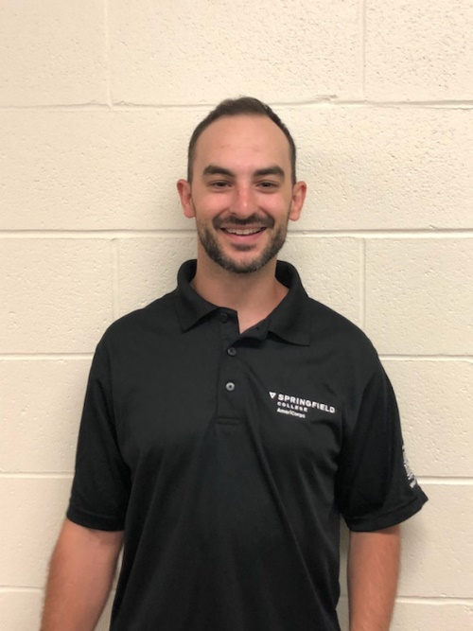
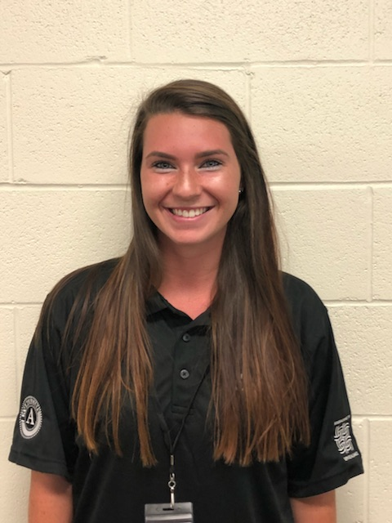
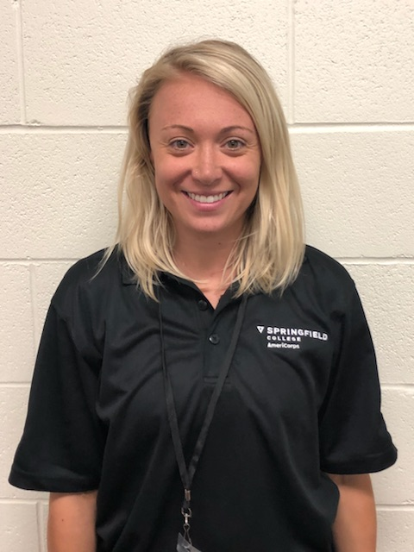
Service Project Panel
Nick Nicole Rachel
SERVICE SITE: KILEY MIDDLE SCHOOL
SERVICE PROJECT: FAMILY ENGAGEMENT HARVEST FESTIVAL
DATE COMPLETED: NOVEMBER 10, 2018

Slide 7
Service Project Reminders
Proposals are due in January
Submit a project proposal at any time
Expenses are reimbursable
(include estimated budget in project proposal)
Humanics in Action mini-grants
(can help with additional funding towards projects)

Slide 8
Three Letters From Teddy
http://www.our-kids.org/Archives/Teddys_3_letters.html

Slide 9
Word Cloud: Assets

Slide 10
Word Cloud: Missing From Toolbox

Slide 11
What Comes to Mind?

Slide 12
What Comes to Mind?

Slide 13
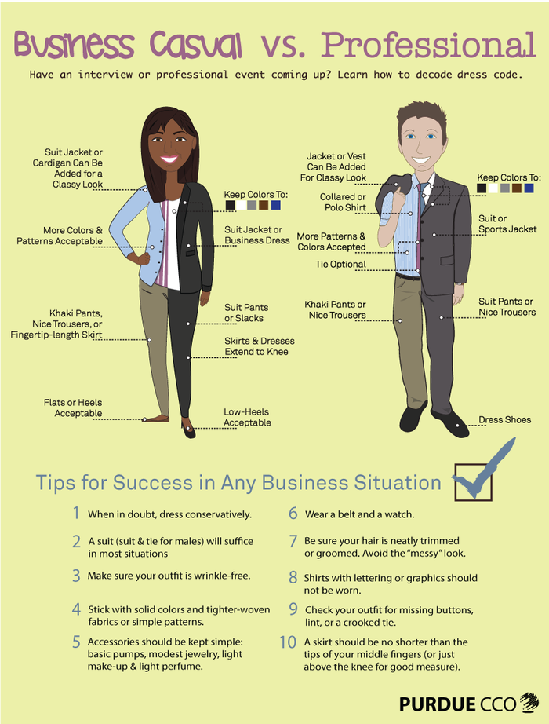
Dressing For Success

Slide 14
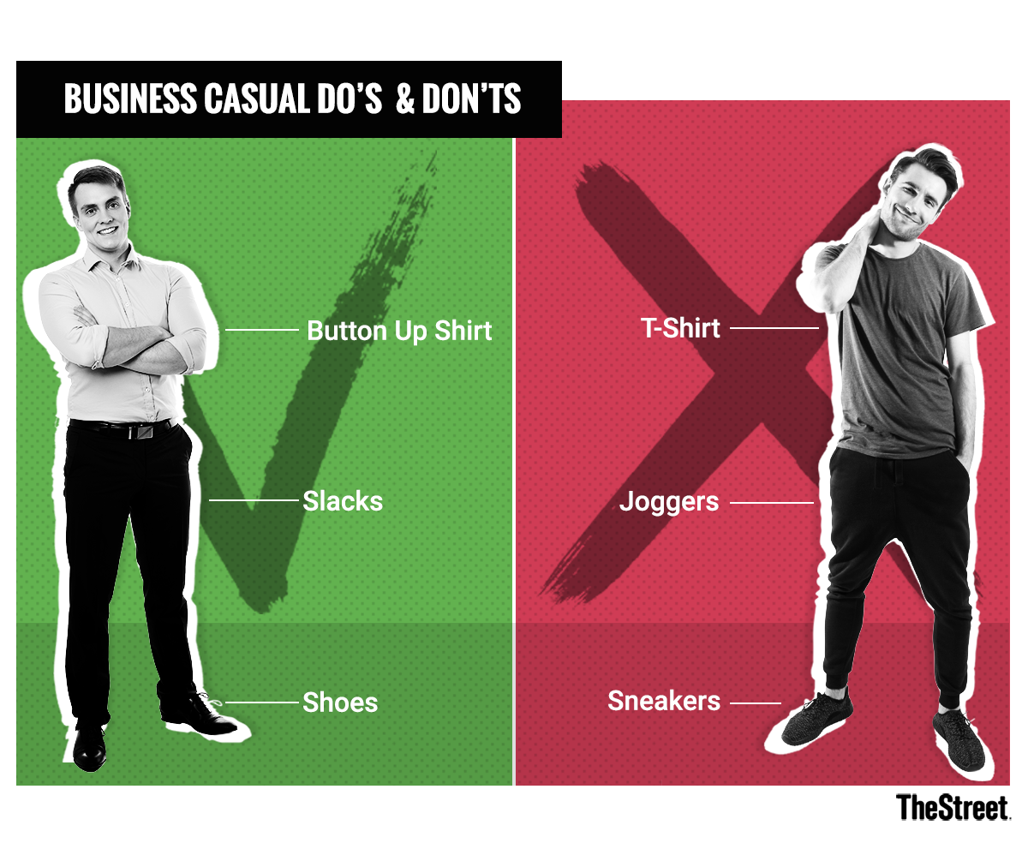
Business Casual Do’s & Don’ts

Slide 15
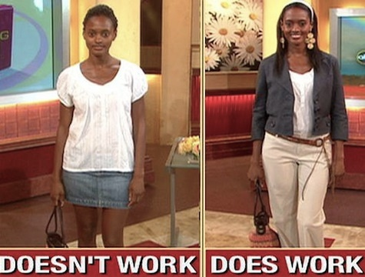
Business Casual Do’s & Don’ts

Slide 16
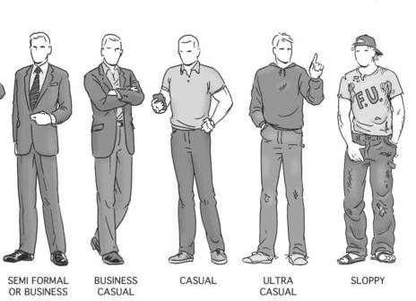
Business Casual Do’s & Don’ts

Slide 17
Springfield College Dress Code
3.13 Dress and Grooming (Springfield College Employee Handbook 2018)
Dress, grooming, and personal hygiene standards contribute to the morale of all employees and affect the professional image of the College. The College takes a conservative stance on dress code and asks that work-appropriate attire is worn at all times…Work appropriate shoes must be worn year-round and clothing must always be neat and clean. Tank tops, sheer clothing, tight or revealing garments, shirts with “graphics or text” (except Springfield College logo apparel) or flip flops should not be worn at any time.
In all cases, apparel must be designed in inoffensive styles and fabrics and appropriate for business purposes. For those days designated as “casual”, employees should work with their department supervisor on determining appropriate attire for their position and duties. During observed summer hours, unless directed otherwise by management, employees are allowed to dress in more business casual attire and in clothing that is seasonally appropriate.
Employees who are dressed inappropriately may be sent home and directed to return to work in proper attire. Under such circumstances, employees may not be compensated for the time away from work. Colognes, perfumes and body sprays should be used modestly and should not be sprayed while at work, as they may cause medical complications for employees within close proximity.

Slide 18
Pet Peeves
What are some of your pet peeves at your site?
How do you deal with them?
Please write down on the piece of paper and drop it in basket.

Slide 19
Questions

Slide 20
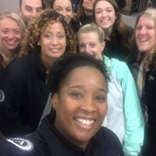
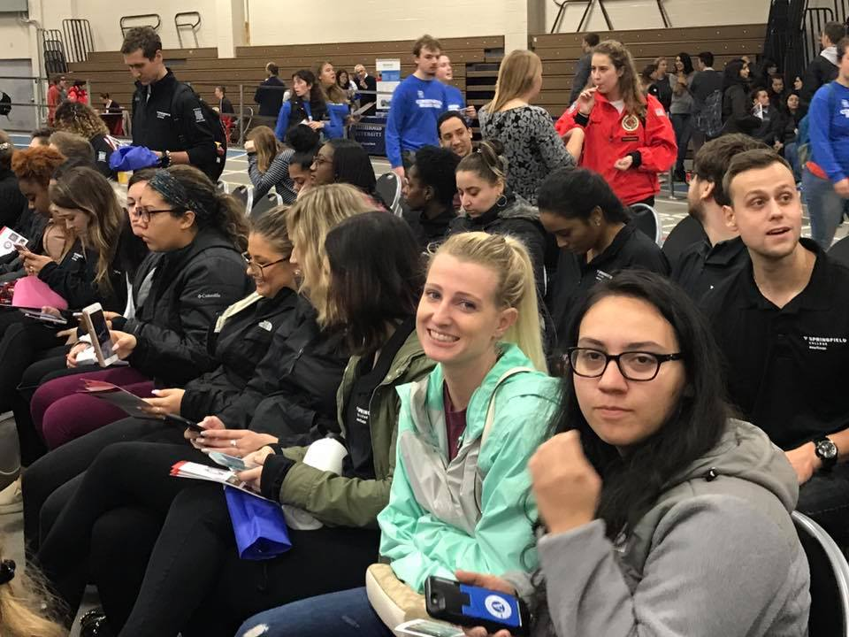
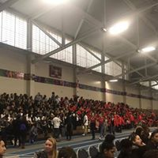
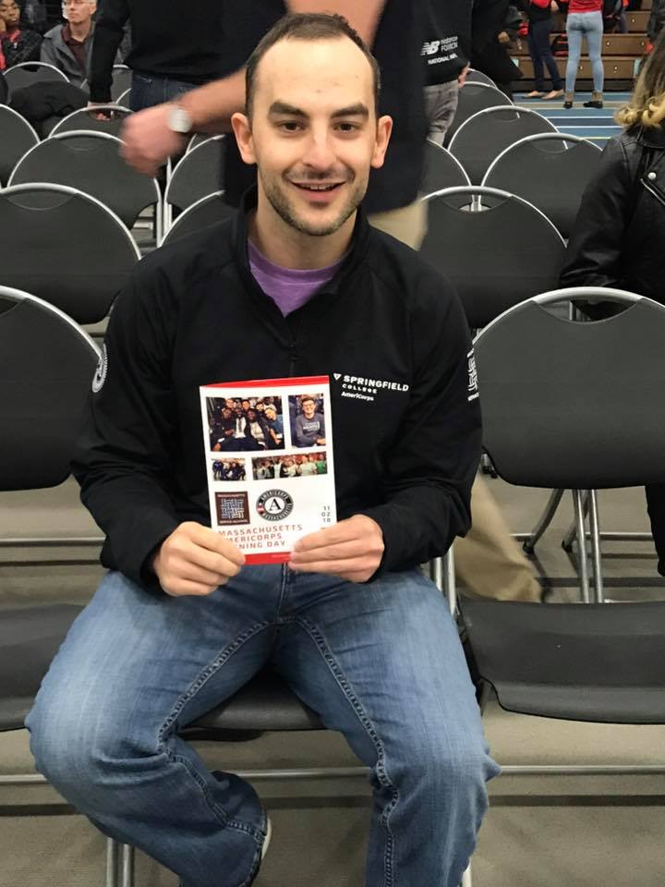
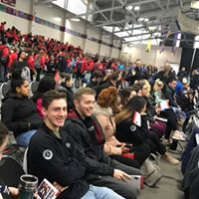
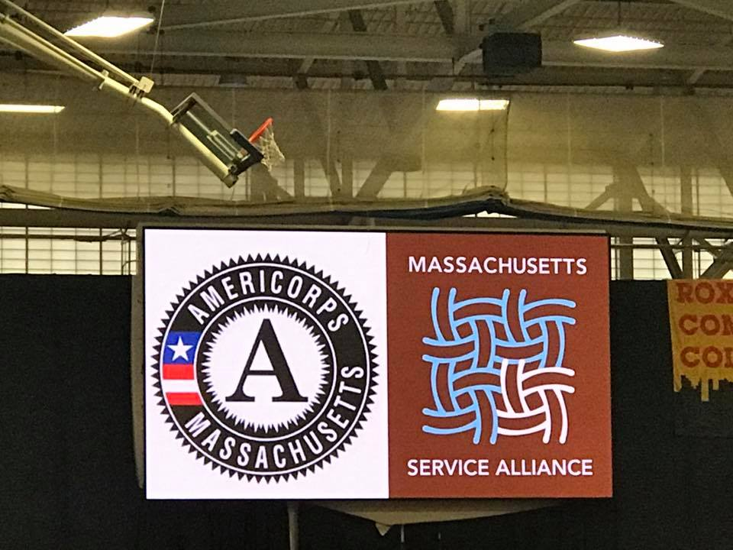
Keep Up The Good Work!

Slide 21
Please Reach Out!
LaTonia Naylor lnaylor@springfieldcollege.edu
413-748-3610
Murielle Georges mgeorges4@springfieldcollege.edu
413-748-3403

