Slide 1
Ho
w to Enter Student Caseload Data
Springfield College AmeriCorps 2018–2019
Member Meeting
October 2018
(will be available in the Resources Section on the OnCorps Portal)

Slide 2
Agenda
Sign In
Take Scrap Paper and Pencil
Name Check In & One Word or Phrase
How are you feeling today?
Updates:
SPS WiFi
Power School Access
Sexual Harassment Training – Link from Everfi
Volunteer Opportunities
Like us on Facebook, Follow us on Instagram and/or Twitter
Training on 10/18 around 3pm on Self-Care While Supporting Students
Data entry – caseloads – CDW training – Student pre and post survey
Service Projects (proposals, expenses, Humanics in Action mini-grants, etc.)
Opening Day on 11/2/2018
Discussion / Partner Exercise
Questions
Your Asset Value / What’s missing from your toolbox?

Slide 3
Member Updates:
SPS WiFi (accessible or not)
Power School Access as AmeriCorps
Sexual Harassment Training – Link from Everfi
Volunteer Opportunities
Add to your service hours
Upcoming Opportunities (WGBY, Veterans Affairs, Stop the Violence March and Resource Fair, Humanics in Action, afterschool programs, etc.)
Like us on Facebook, Follow us on Instagram and/or Twitter
Weekly member spotlight
Weekly News Update via email every Monday
Training on 10/18 around 3pm on Self-Care While Supporting Students

Slide 4
Member Updates:
Student Data
How many have caseloads?
Intervention Tracking
Power School / Community Data Warehouse Workshops
Student Pre and Post Surveys (ready next week)
Service Projects
Proposals are due in January
Submit a project proposal at any time
Expenses are reimbursable (include estimated budget in project proposal)
Humanics in Action mini-grants (can help with additional funding towards projects)
Opening Day on 11/2/2018
Sign-up to confirm your attendance
Bus loading at 6:45am
Bus departs at 7:00am
Bus leaves Boston at 4:00pm
Service project ideas while in Boston (preference?)
No Monthly November Meeting

Slide 5
Groups or Pairs Discussion
Discussion Questions:
Things you didn’t think you’d be doing as an AmeriCorps member but are.
Things you hoped to do as an AmeriCorps member, but didn’t realize how it would affect you.

Slide 6
Questions

Slide 7
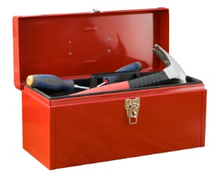
Things that make you go Hmm…
Answer these questions (anonymously) on scrap paper and leave in the basket.
What is your Asset Value?
What’s missing from your toolbox?

Slide 8
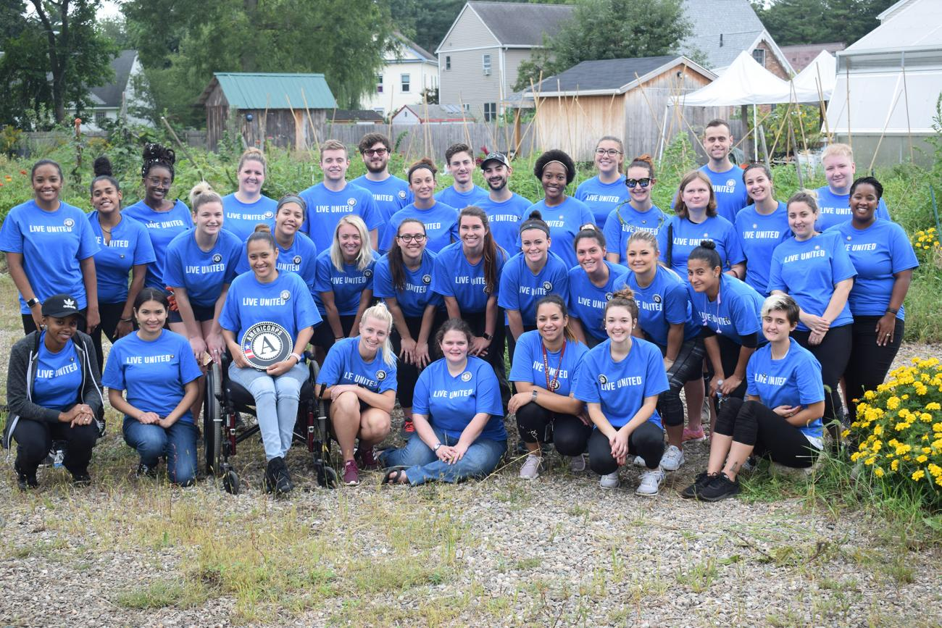
Keep up the good work!
To read more, visit: https://springfield.edu/news/springfield-college-americorps-takes-part-united-way-day-caring
To see the video, visit: https://www.youtube.com/watch?v=Jp1lmdIh5XM#action=share

Slide 9
How to Enter Student Caseload Data
Let us know if you have any questions.
LaTonia Naylor – lnaylor@springfieldcollege.edu 413-748-3610
Murielle Georges mgeorges4@springfieldcollege.edu 413-748-3403

